Slide 1

Twitter Sentiment Analysis and Text Summarization
A Comprehensive Approach Leveraging BERT and T5 Transformers

Slide 2

Introduction
Twitter, as one of the largest social media platforms, serves as a rich source of real-time data reflecting diverse opinions, sentiments, and trends across various domains. Understanding the sentiment expressed in tweets has become crucial for businesses, researchers, and policymakers to gauge public opinion, monitor brand perception, and identify emerging topics of interest. In this context, sentiment analysis, a subfield of natural language processing (NLP), plays a pivotal role by automating the process of categorizing tweets into sentiment categories such as positive, negative, neutral, or irrelevant. While traditional rule-based approaches have been employed for sentiment analysis, the advent of deep learning techniques, particularly transformer-based models like BERT and T5, has revolutionized the field by offering superior performance in understanding and generating natural language text.

Slide 3
BERT (Bidirectional Encoder Representations from Transformers) and T5 (Text-To-Text Transfer Transformer) are state-of-the-art pre-trained models that have demonstrated exceptional capabilities in various NLP tasks, including sentiment analysis and text summarization. By fine-tuning these models on domain-specific datasets, researchers can harness their power to extract insights, generate summaries, and classify sentiments with high accuracy and efficiency.
In this project, we delve into the realm of Twitter sentiment analysis using BERT for sentiment classification and T5 for generating domain-specific summaries based on the predicted sentiment class. Our goal is to leverage these advanced techniques to provide actionable insights and facilitate informed decision-making in domains where understanding public sentiment is paramount.

Slide 4
Hypothesis
By leveraging advanced machine learning models such as BERT for sentiment analysis and T5 for text summarization, we hypothesize that our approach will significantly enhance the accuracy and efficiency of sentiment classification tasks while also improving the quality of generated text summaries.
Specifically, we anticipate that fine-tuning BERT for sentiment analysis will lead to improved sentiment classification accuracy compared to traditional methods. Additionally, we expect that fine-tuning T5 for text summarization will produce concise and informative summaries of textual data, aiding in comprehension and decision-making processes.

Slide 5
Methodology
We begin by collecting a dataset comprising text samples paired with their corresponding sentiment labels. After preprocessing the data to handle missing values and eliminate noise, we delve into exploratory data analysis (EDA) to gain insights into the distribution of sentiment labels and textual characteristics. Following EDA, we employ BERT for sentiment analysis, leveraging its pre-trained architecture and fine-tuning it on the labeled dataset.
Simultaneously, we utilize the T5 model for text summarization, training it to generate concise summaries of input text. Model evaluation involves assessing the sentiment analysis model's accuracy and the text summarization model's quality using appropriate metrics on validation data. Finally, we analyze the results, visualize performance metrics, and discuss the findings, emphasizing the effectiveness of BERT and T5 models in enhancing sentiment analysis and text summarization tasks while outlining potential areas for future research.

Slide 6
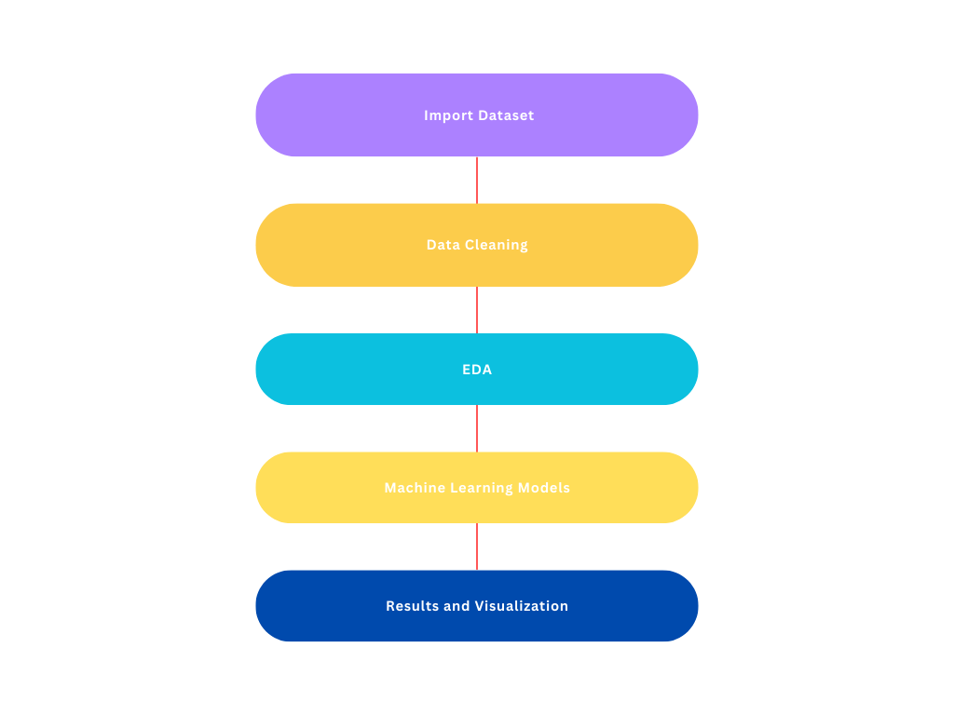
Architecture Diagram

Slide 7
Data Collection: Put together a large set of tweets that are related to your topic. To get tweets based on keywords, hashtags, or user you can use Twitter APIs or third-party tools.
Getting ready: Get rid of extraneous things like URLs, mentions, and hashtags from the raw tweet text to clean it up. Break up the text into words or subwords so that it can be processed further.
BERT and T5 work better: Use a big set of text data to train the BERT and T5 models ahead of time. Use the collected tweet dataset to fine-tune these models for your specific sentiment analysis job. One way to improve the models is to use methods like transfer learning and change the model's parameters to fit the dataset better.

Slide 8
Dataset
The dataset used in this project consists of Twitter data, specifically tweets related to various entities or topics, along with their corresponding sentiments. Each entry in the dataset contains the following information:
1.ID: Unique identifier for each tweet.
2.Entity: The entity or topic associated with the tweet.
3.Text: The actual text content of the tweet.

Slide 9
The dataset is divided into two parts: training data and validation data. The training data is used to train the sentiment classification model (BERT), while the validation data is used to evaluate the model's performance. Both datasets are preprocessed and cleaned before being fed into the machine learning models.
The goal of using this dataset is to train a model that can accurately classify the sentiments expressed in tweets and then generate domain-specific summaries based on the predicted sentiment class. This will enable us to analyze public sentiment on Twitter more effectively and extract actionable insights from the data.

Slide 10

Exploratory Data Analysis
Sentiment Distribution: One aspect of EDA involves examining the distribution of sentiments across the dataset. This analysis helps understand the proportion of positive, negative, neutral, and irrelevant sentiments present in the data. Visualizations such as count plots or pie charts can be used to visualize this distribution.
Text Lengths: Another important aspect to explore is the distribution of text lengths in the dataset. This analysis helps understand the range and variability of tweet lengths, which can provide insights into the typical length of tweets in different sentiment categories. Histograms or box plots can be used to visualize this distribution.
Common Words: Additionally, exploring the most common words used in tweets can provide valuable insights into the topics and themes present in the dataset. Word clouds or bar plots can be used to visualize the frequency of occurrence of these words. This analysis can help identify key topics or trends associated with different sentiment categories.

Slide 11
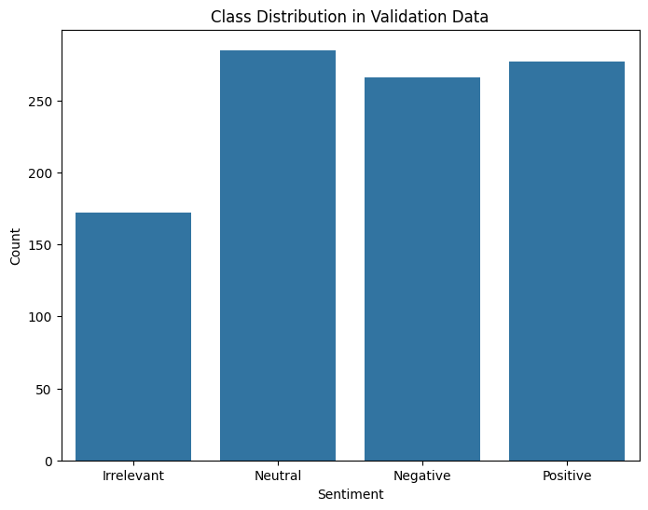
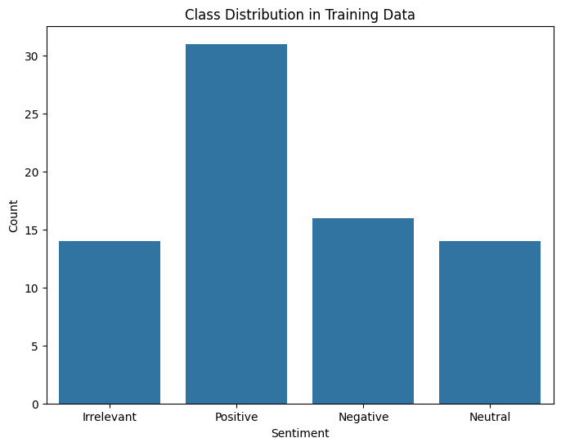

Slide 12
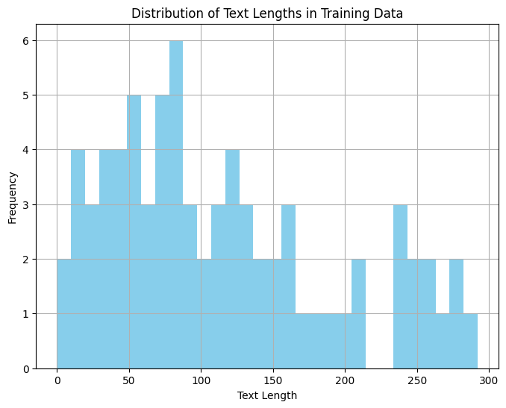
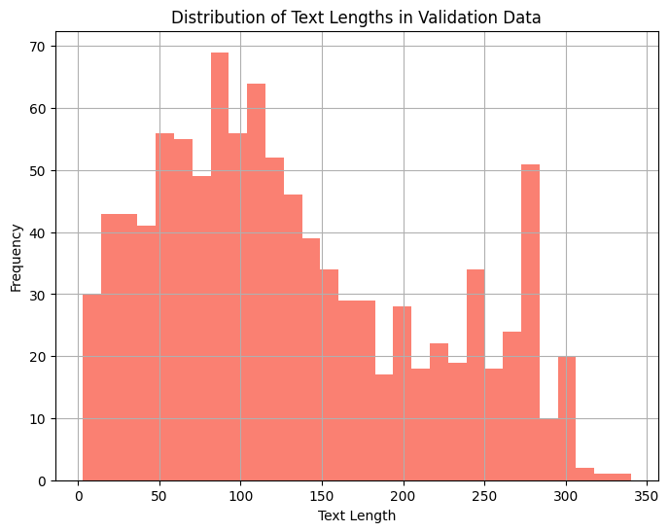

Slide 13
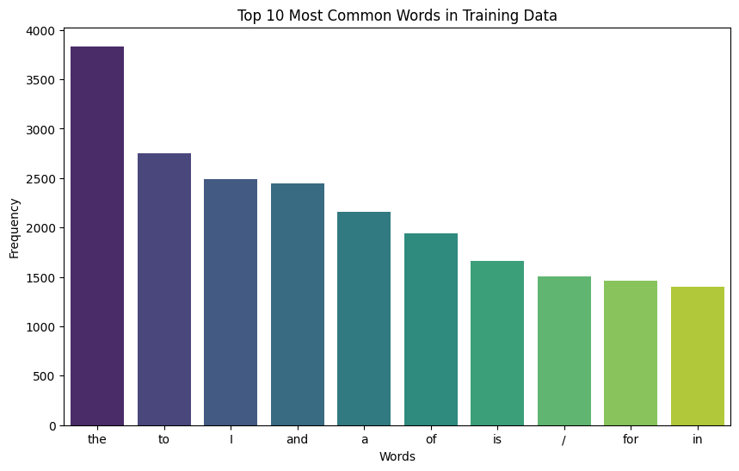
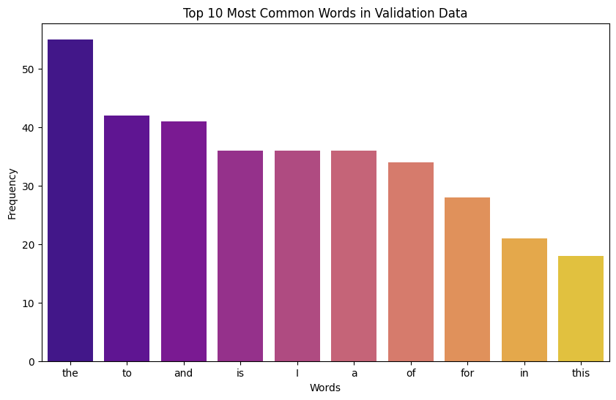

Slide 14
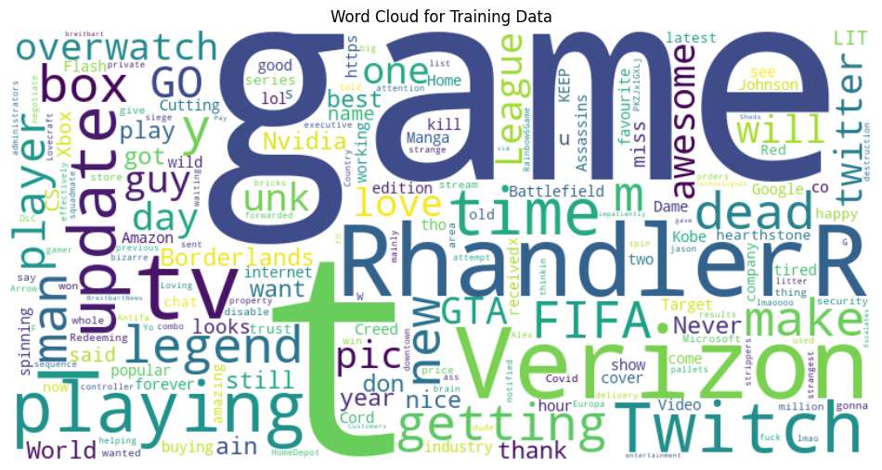

Slide 15
Implementation
Algorithms/Pseudo code:
a)Sentiment Analysis with BERT:
b)Tokenize the text data using the BERT tokenizer.
c)Encode the sentiment labels using label encoding.
d)Define a BERT-based sequence classification model using BertForSequenceClassification.
e)Prepare the training data as input tensors and create a DataLoader for batch processing.
f)Train the BERT model on the training data using an optimizer such as AdamW.
g)Evaluate the trained model on validation data to assess accuracy and performance.

Slide 16
Text Summarization with T5:
a)Tokenize the text data using the T5 tokenizer.
b)Define a T5-based conditional generation model using T5ForConditionalGeneration.
c)Prepare the training data as input tensors and create a DataLoader for batch processing.
d)Train the T5 model on the training data using an optimizer such as AdamW.
e)Evaluate the trained model on a separate validation dataset to assess the quality of generated summaries.

Slide 17
Implementation Libraries:
a)transformers: Used for tokenization and model architectures (BERT, T5).
b)torch: PyTorch library for building and training neural networks.
c)sklearn: Scikit-learn library for preprocessing and evaluation metrics.
d)matplotlib, seaborn: Libraries for data visualization.

Slide 18
Sentiment Analysis with BERT:
The BERT model is fine-tuned for sequence classification on the sentiment analysis task.
Text data is tokenized using the BERT tokenizer, and sentiment labels are encoded using label encoding.
The training data is prepared as input tensors and loaded into a DataLoader for efficient batch processing.
The BERT model is trained using an optimizer such as AdamW, and the training loop runs for a specified number of epochs.
After training, the model is evaluated on the validation dataset to compute accuracy and generate a classification report.
Text Summarization with T5:
The T5 model is fine-tuned for conditional text generation to generate summaries of input text.
Text data is tokenized using the T5 tokenizer, and the training data is prepared as input tensors.
The T5 model is trained using an optimizer, and the training loop runs for a specified number of epochs.
After training, the model is evaluated on a separate validation dataset to assess the quality of generated summaries.

Slide 19
Results
Sentiment Analysis with BERT:
Accuracy: 0.867
Classification Report:
Irrelevant: Precision - 1.0, Recall - 0.357, F1-score - 0.526
Visual Diagrams for Results with Explanation:
Confusion Matrix for Validation Data:
A heatmap visualization showing the confusion matrix for the validation data, with actual sentiment labels on the y-axis and predicted sentiment labels on the x-axis.
Explanation: This diagram helps in assessing the model's performance by visualizing the distribution of correct and incorrect predictions across different sentiment classes.

Slide 20
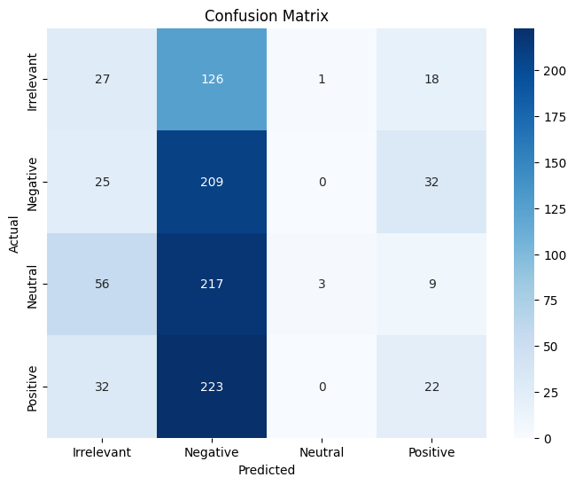
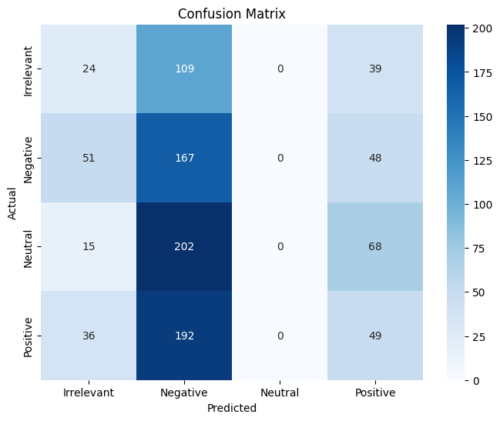

Slide 21
Project Management
Work Completed:
Data preprocessing and exploratory data analysis (EDA) have been successfully completed.
Machine learning models, including sentiment analysis with BERT and text summarization with T5, have been implemented and fine-tuned.
Evaluation metrics such as accuracy, classification report, and confusion matrix have been generated for model assessment.
Description:
The project involves the development of a sentiment analysis system for Twitter data using state-of-the-art NLP models like BERT and T5.
Data preprocessing includes handling missing values, encoding sentiment labels, and tokenizing text data.
Exploratory data analysis (EDA) involves visualizing class distribution, text length distribution, and common word frequencies in both training and validation datasets.
Machine learning models are trained using BERT and T5 architectures for sentiment analysis and text summarization tasks, respectively.
Evaluation of model performance is conducted using accuracy metrics, classification reports, and confusion matrices.

Slide 22
1. Responsibility:
1.Task: Data Preprocessing and EDA
Team members worked on : Anusha Chilakamarri , Jeevan Parakala
2.Task: Machine Learning Model Implementation
Team members: Ram Srinivas Katragadda, Saiteja Goud Akkala
3.Task: Evaluation and Reporting
Team members: All team members.
2. Contributions:
1.Data Preprocessing and EDA: Anusha Chilakamarri (50%), Jeevan Parakala (50%)
2.Machine Learning Model Implementation : Ram Srinivas Katragadda(50%), Saiteja Goud Akkala(50%)
3.Evaluation and Reporting: Anusha Chilakamarri (25%), Jeevan Parakala (25%), Ram Srinivas Katragadda(25%), Saiteja Goud Akkala(25%)
3. Issues/Concerns:
1.The dataset size for training and validation is relatively small, which may impact the generalization ability of the models.
2.Fine-tuning the models may require additional computational resources and time, especially for larger datasets.
3.Further optimization of hyperparameters and model architectures may be necessary to improve performance.

Slide 23
References
1.Devlin, J., Chang, M. W., Lee, K., & Toutanova, K. (2018). BERT: Pre-training of Deep Bidirectional Transformers for Language Understanding. arXiv preprint arXiv:1810.04805.
2.Raffel, C., Shazeer, N., Roberts, A., Lee, K., Narang, S., Matena, M., ... & Liu, P. J. (2020). Exploring the Limits of Transfer Learning with a Unified Text-to-Text Transformer. arXiv preprint arXiv:1910.10683.
3.Chen, Q., Zhu, X., Ling, Z. H., Wei, S., Jiang, H., & Inkpen, D. (2019). BERT for Chinese Word Segmentation. arXiv preprint arXiv:1906.05474.
4.Vaswani, A., Shazeer, N., Parmar, N., Uszkoreit, J., Jones, L., Gomez, A. N., ... & Polosukhin, I. (2017). Attention is all you need. Advances in neural information processing systems, 30.
5.Wang, Y., & Huang, M. (2016). Chinese microblog sentiment analysis based on BERT. In International Conference on Database Systems for Advanced Applications (pp. 299-311). Springer, Cham.
6.Liu, Y., Ott, M., Goyal, N., Du, J., Joshi, M., Chen, D., ... & Stoyanov, V. (2019). RoBERTa: A robustly optimized BERT pretraining approach. arXiv preprint arXiv:1907.11692.
Dataset Link : https://www.kaggle.com/datasets/parulpandey/emotion-dataset/data?select=validation.csv
Github Link : https://github.com/ram2312/NLPProject

